Slide 1



Software Development and Professional Practices
Cross-Platform Application Development - Flutter

Slide 2
Objectives
Understand what cross-platform app development.
Introduce Flutter
Architecture
Installation
Dart Overview
Sample Application

Slide 3
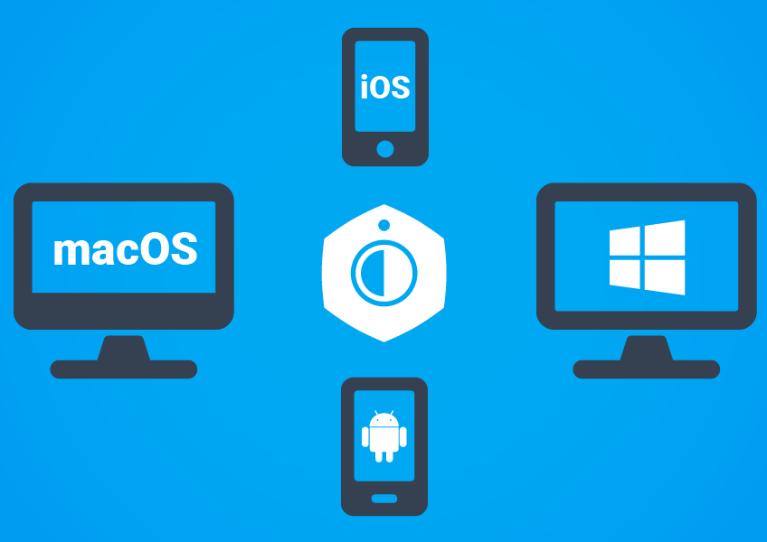
Cross-Platform Application Development
Cross-platform application development is about building a single application that can run on various operating systems, instead of developing different app versions for each platform.

Slide 4
Cross-Platform Application Development
Business Benefits of Cross-Platform Development
Business Benefits
Launching the software simultaneously on various platforms
Faster development time
Reaching a wider audience
Faster and easier updates
Cost savings

Slide 5
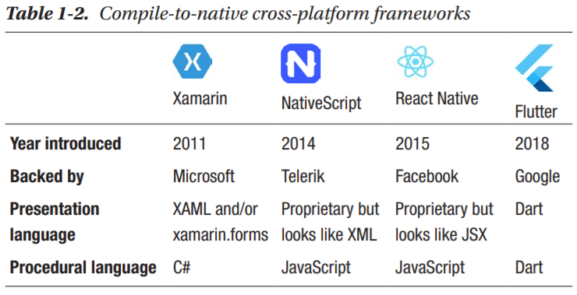
Cross-Platform Application Development
Cross-platform development frameworks
Notes:
https://dotnet.microsoft.com/apps/Xamarin
https://nativescript.org/
https://reactnative.dev/
https://flutter.dev/
https://www.embarcadero.com/products/delphi

Slide 6
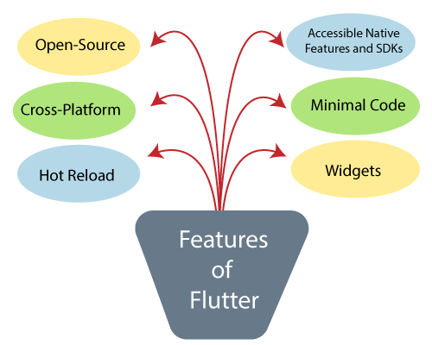
Flutter
Flutter is a UI toolkit for creating fast, beautiful, natively compiled applications for mobile, web, and desktop with one programming language and single codebase.
free and open-source
developed by Google
use Dart programming language

Slide 7
Flutter
During development, Flutter apps run in a VM that offers stateful hot reload of changes without needing a full recompile.
For release, Flutter apps are compiled directly to machine code, whether Intel x64 or ARM instructions, or to JavaScript if targeting the web.

Slide 8
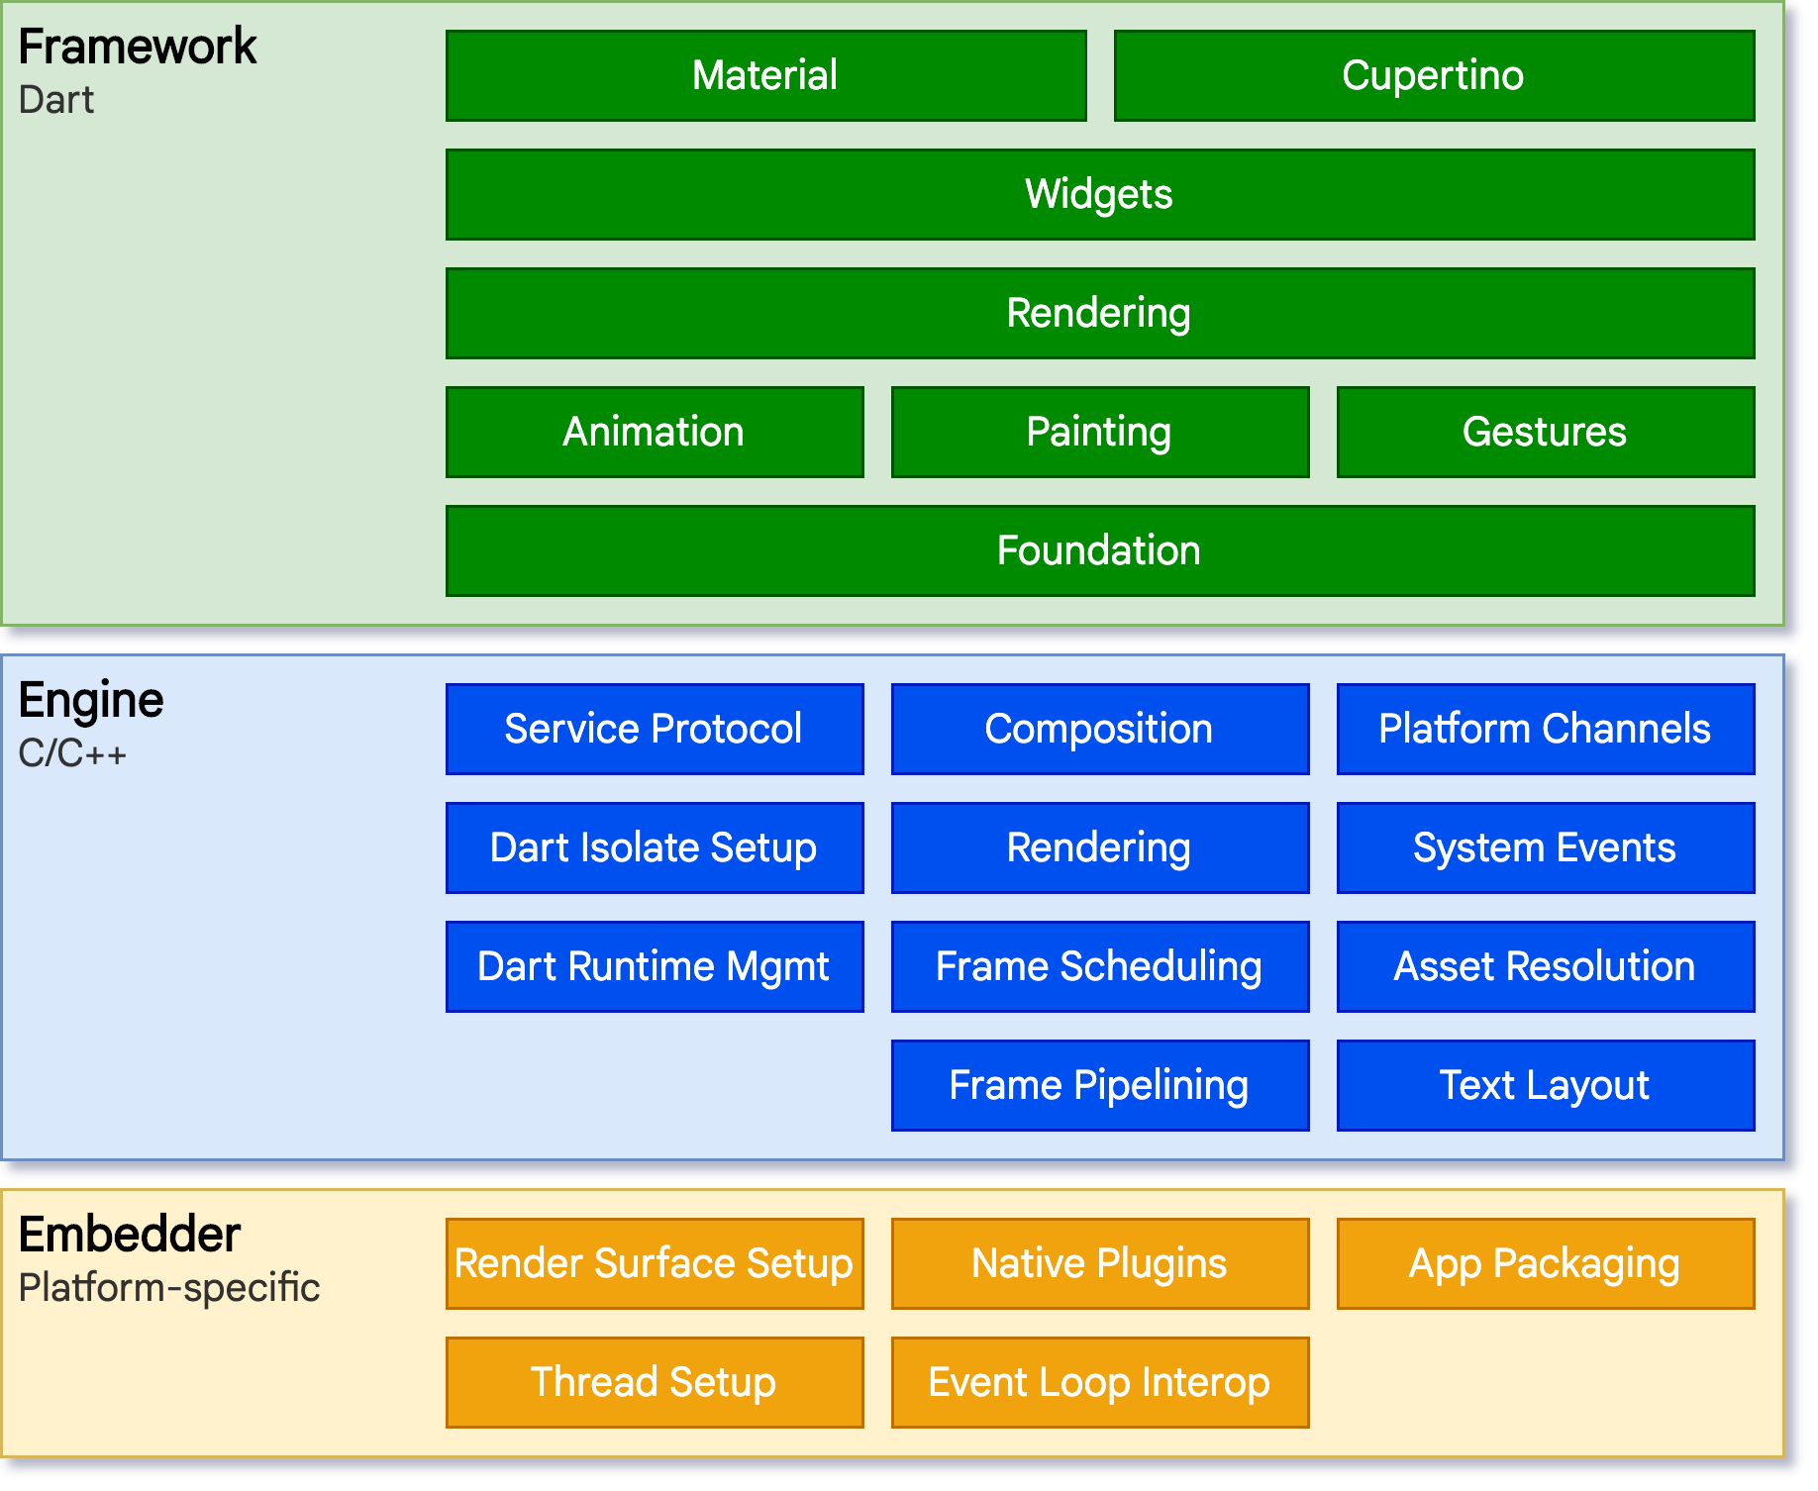
Flutter – Architecture
Flutter is designed as an extensible, layered system.
It exists as a series of independent libraries that each depend on the underlying layer.

Slide 9

Flutter – Architecture
In Flutter everything is a Widget.
Widgets are the building blocks of a Flutter app’s user interface
Widgets form a hierarchy based on composition.
Each widget nests inside its parent and can receive context from the parent.
The container that hosts the Flutter app, typically $MaterialApp$ or $CupertinoApp$

Slide 10
Flutter – Architecture
In Flutter everything is a Widget.
Widget
Stateless Widget
Stateful Widget
Text
Icon
Checkbox
…
…
Animation

Slide 11

Flutter – Architecture
In Flutter everything is a Widget. https://flutter.dev/docs/development/ui/widgets
Stateless Widget: The widgets whose state can not be altered once they are built are called stateless widgets (immutable). ($Icon$, $Text$, $Button$, $Image$, …)
Stateful Widgets: The widgets whose state can be altered once they are built (mutable). ($RadioButton$, $CheckBox$, $TextField$)
Widget
Stateless Widget
Stateful Widget
…
Text
Icon
Checkbox
…
…
Animation

Slide 12
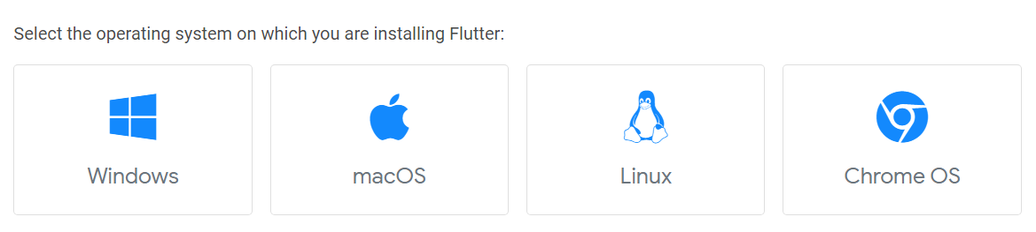
Flutter - Installation
Follow the installation steps
1. Select your operating system

Slide 13
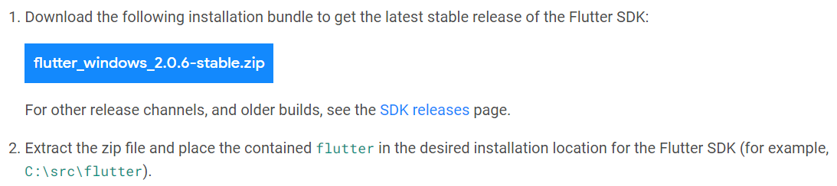
Flutter - Installation
Follow the installation steps
2. Download Flutter SDK

Slide 14
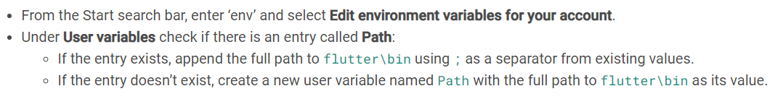
Flutter - Installation
Follow the installation steps
3. Update the PATH environment variable

Slide 15
Flutter - Installation
Follow the installation steps
4. Run Flutter doctor tool in cmd to see if there are any platform dependencies you need to complete the setup:

Slide 16
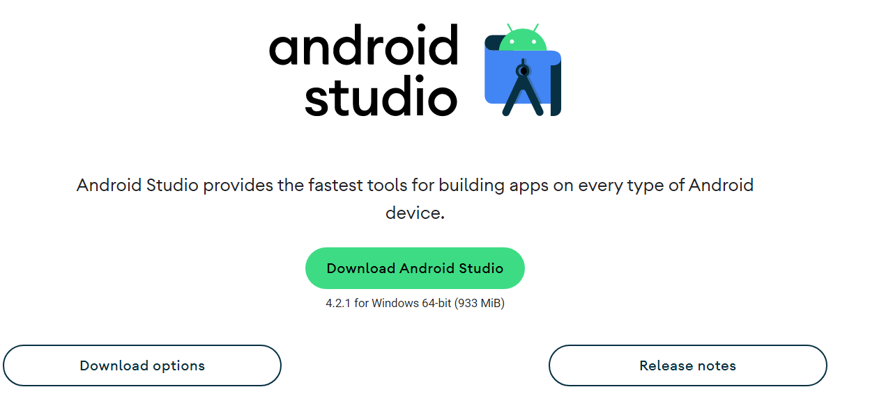
Flutter - Installation
Follow the installation steps
5. Download Android Studio/intellij IDEA + Android SDK
https://developer.android.com/studio

Slide 17
Flutter - Installation
Follow the installation steps
6. Set up your Android device
Enable Developer options and USB debugging on your device.
Install the Google USB Driver.
7. Set up the Android emulator

Slide 18
Flutter - Installation
Follow the installation steps
8. To enable windows development, install visual studio 2019 with C++
9. Enable Desktop support in Flutter

Slide 19

Flutter - Installation
Follow the installation steps
10. Install Flutter plugin in the IDE

Slide 20
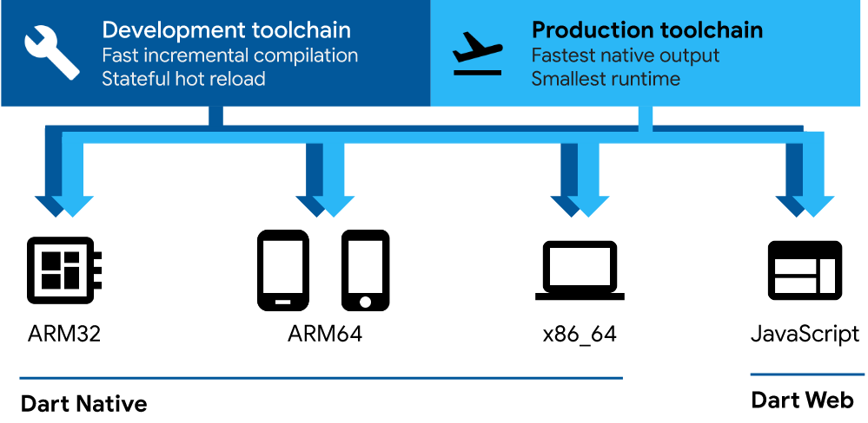
Flutter - Dart
Dart is a client-optimized language for developing fast apps on any platform.

